Slide 1
Unit 5: NIMS Coordination: MAC Groups and the Joint Information System
Unit 5:
NIMS Coordination: MAC Groups and the Joint Information System

Slide 2

Unit Terminal Objective
Explain the interconnectivity between the MAC Group, EOCs, the Joint Information System, and Incident Command.

Slide 3
Unit Enabling Objectives
  Explain the functions and purpose of a Multiagency Coordination Group.
  Explain the functions and purpose of a Joint Information System.
  Describe the interconnectivity of the NIMS Command and Coordination systems.

Slide 4
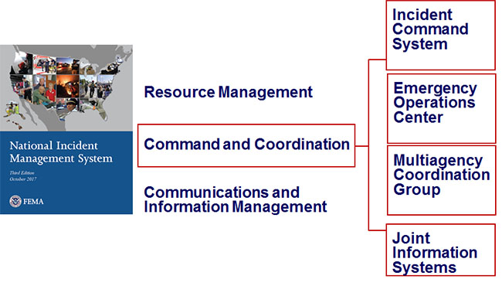
NIMS Components

Slide 5
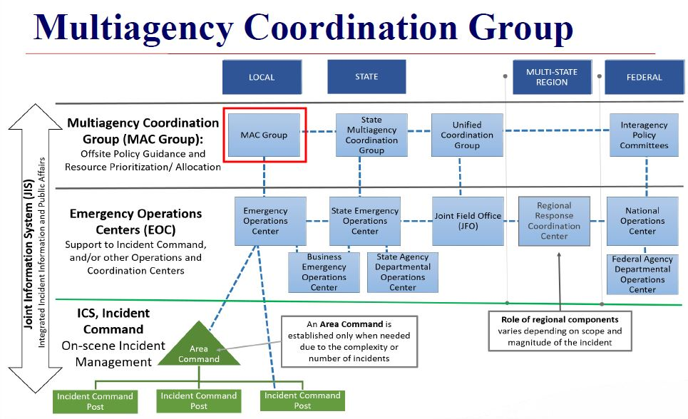
Multiagency Coordination Group

Slide 6
The MAC Group
  Provides policy guidance
  Supports resource prioritization and allocation
  Enables decision-making among elected and appointed officials and senior executives
  Is often comprised of:
    Elected officials
    Senior decision-makers
    Senior public safety officials
    High-level, subject-matter experts

Slide 7
The SR Official/MAC Group Role
  Define the mission and strategic direction
  Identify operational priorities
  Provide policy guidance to EOC, IC and JIC/PIO
  Resolve scarce resource allocation issues
  Delegate command authority to the IC/ UC
  Delegate appropriate authority to the EOC and JIS
  Determine the MAC Group decision-making process
  Determine who will be included in the MAC Group
  Issue Initial Policy Statement to guide the EOC
  Determine reporting requirements

Slide 8
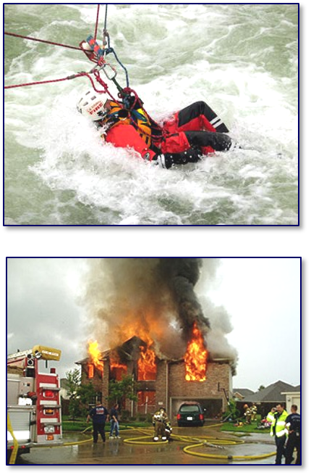
Operational Priorities
MAC Groups apply priorities at policy level:
  Save lives
  Protect property and environment
  Stabilize the incident
  Provide for basic human needs
  Restore essential utilities.
  Restore essential program functions.
  Coordinate among appropriate stakeholders
  Represent Political, Financial and Legal Concerns.

Slide 9
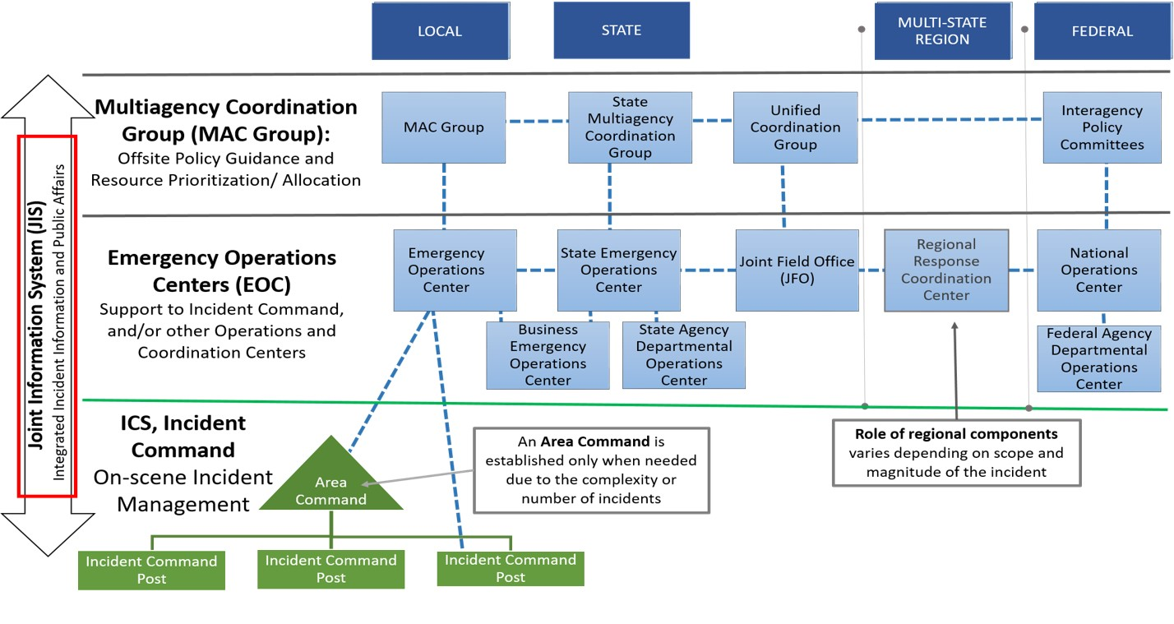
Joint Information System

Slide 10
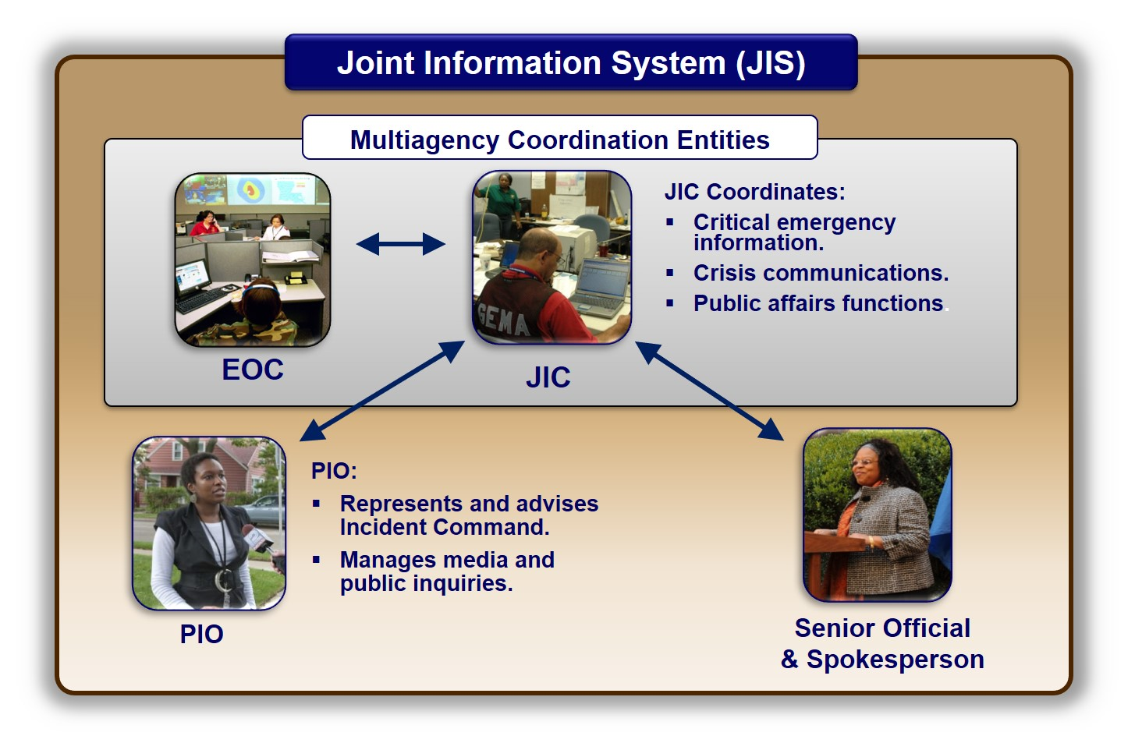
Joint Information System (JIS) Graphic

Slide 11

Managing Public Information
The Public Information Officer (PIO):
  Manages media and public inquiries.
  May be separate PIOs for:
    Incident Command
    EOC
    Senior Official / MAC Group
PIOs coordinate and disseminate incident information through the JIC:
  Critical emergency information
  Crisis communications
  Public affairs functions

Slide 12
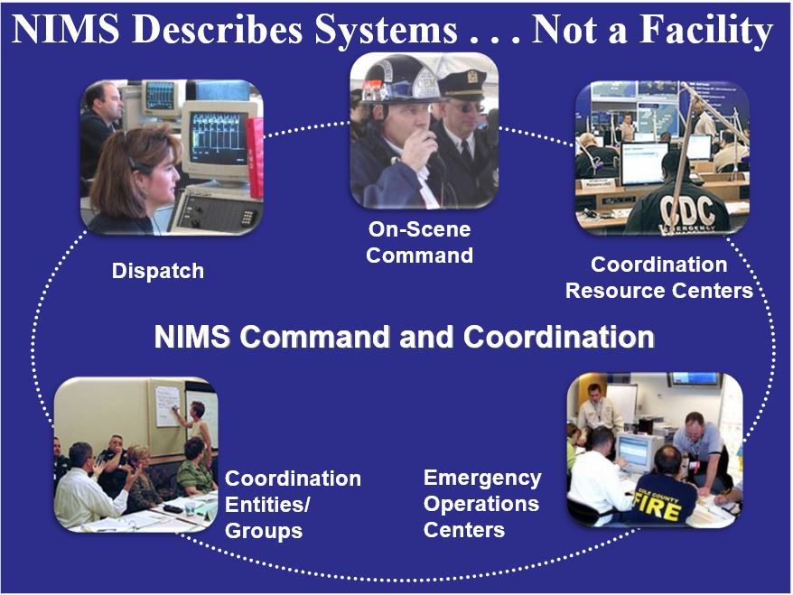
NIMS Describes Systems . . . Not a Facility

Slide 13
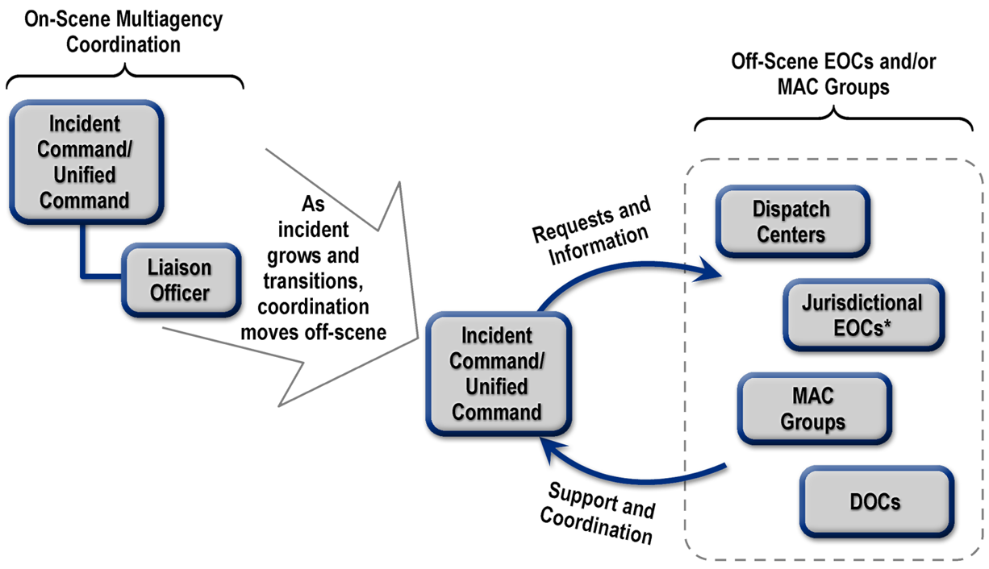
Interconnectivity of NIMS Command and Coordination

Slide 14
Review of the Senior Official's Role
In most jurisdictions the Senior Official is responsible for:
  Ensuring the safety of the citizens and protection of property
  Ensuring the continuity of government
  Activating specific legal authorities (disaster declarations, evacuations, state of emergency, or other protective actions)
  Delegating Authority for Incident Command to an IC/ UC
  Coordinating with the PIO to keep the media and public informed
  Requesting assistance from State agencies through the EOC
  Resolving any resource allocation conflicts
  Coordinating with other Sr. Officials & whole community partners
  Participating in a Multiagency Coordination Group (MAC)

Slide 15
Objectives Review
  What is the purpose of a Multiagency Coordination Group?
  What is the purpose of a Joint Information System?
  How are the NIMS Command and Coordination systems interconnected?

